Slide 1
Cyber Security : Table of Contents
What is Cyber security?
CIA Triad
Specialties in Cyber security
Basic Terminologies
Common Types of Attacks

Slide 2
Cyber Security
Cybersecurity is a popular topic, but do you know why it is essential? We are living in a digital era where data is everything. We must understand that private information is much more vulnerable than ever before. We often hear about data breaches and cases of identity theft that affect millions of consumers. Two years ago, WannaCry ransomware encrypted millions of computers. All companies and institutions are fighting to protect their data against hackers and cybercriminals, and you can also play a role in it. Cybersecurity is not involved only in organizations, but even personal computers, mobile phones, and tablets.

Slide 3
What is Cybersecurity?
let us first understand what exactly is cyber security and what is its significance. Cybersecurity is the technology and process that is designed to protect networks and devices from attacks, damage, or unauthorized access. Cybersecurity is essential for a country’s military, hospitals, large corporations, small businesses, and other organizations and individuals since data is now the cornerstone of any organization. If that data is exploited, then there are a lot of risks. Now, we have understood what cybersecurity is, let’s see what the CIA triad is and how it is related to cybersecurity.

Slide 4
CIA Triad
The security of any organization starts with three principles: Confidentiality, Integrity, Availability. And next in this cyber security for beginners tutorial we will learn about the CIA Triad, which has served as the industry standard for computer security since the time of first mainframes.

Slide 5
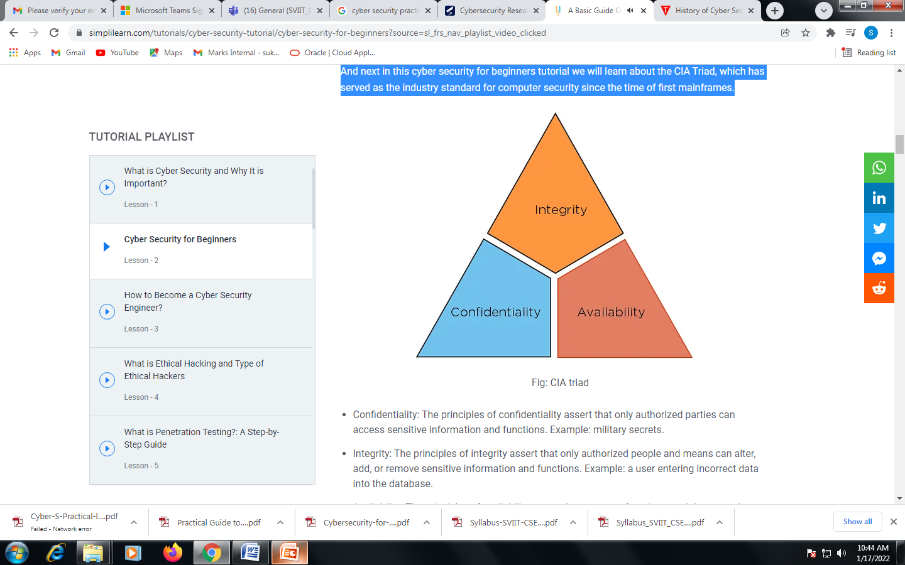
CIA Triad

Slide 6
CIA Triad
Confidentiality: The principles of confidentiality assert that only authorized parties can access sensitive information and functions. Example: military secrets.
Integrity: The principles of integrity assert that only authorized people and means can alter, add, or remove sensitive information and functions. Example: a user entering incorrect data into the database.
Availability: The principles of availability assert that systems, functions, and data must be available on-demand according to agreed-upon parameters based on levels of service.

Slide 7
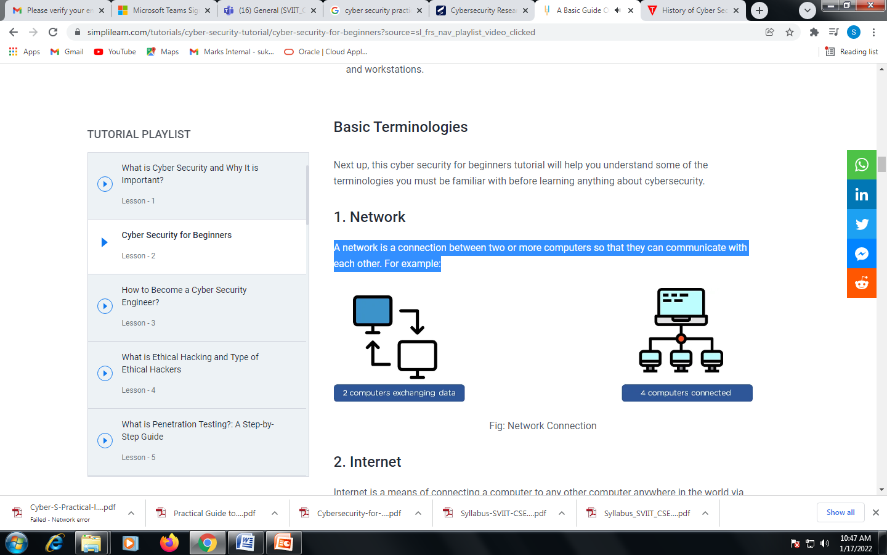
Basic Terminologies
Network
A network is a connection between two or more computers so that they can communicate with each other. For example:

Slide 8
Basic Terminologies
Internet : Internet is a means of connecting a computer to any other computer anywhere in the world via dedicated routers and servers.
Internet Protocols: The data that is transferred or received cannot follow any path. There are a set of rules that are followed to control the flow of the internet. These rules are called internet protocol.
IP Address: An Internet Protocol address (IP address) is an address assigned to all devices that connect to a computer network and uses the Internet Protocol for communication. An IP address looks like this: 168.192.10.3
MAC Address : This is a unique identification number that every device has that connects to the internet. Traditional MAC addresses are 12-digit hexadecimal numbers. MAC address looks like this: D8-FC-93-C5-A5-EO.

Slide 9
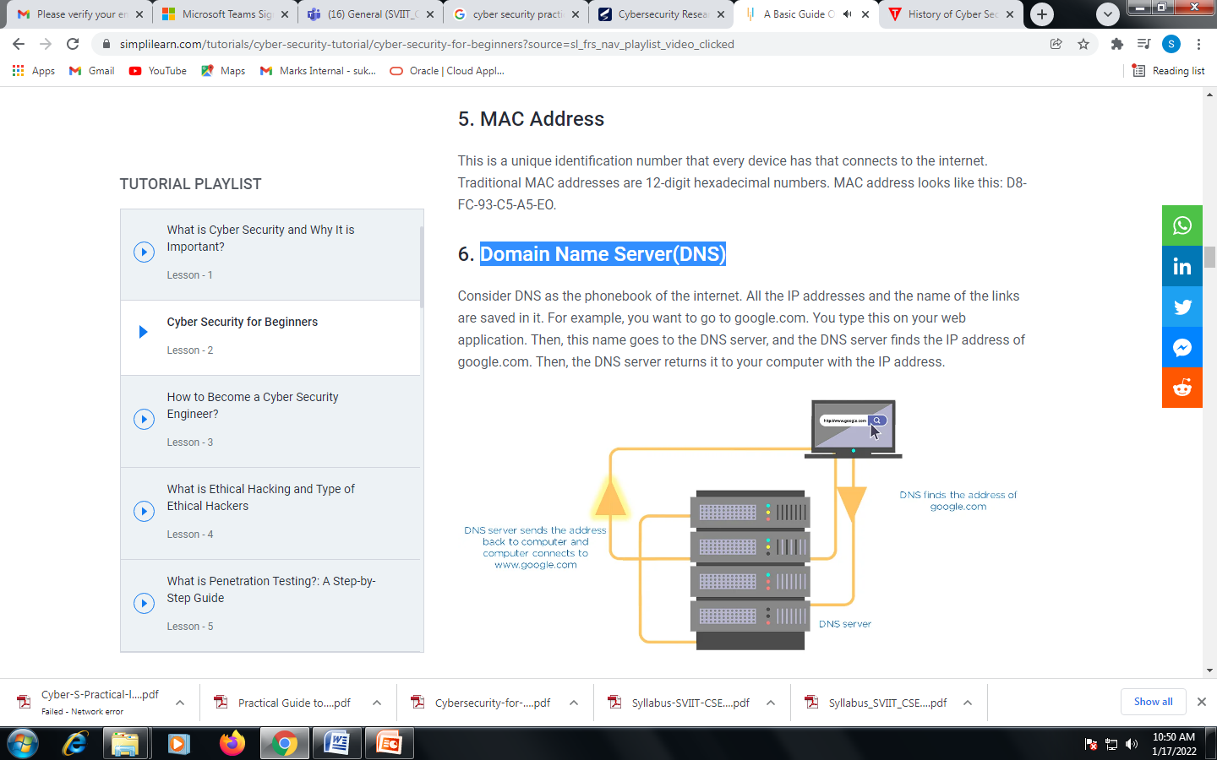
Domain Name Server(DNS)
Consider DNS as the phonebook of the internet. All the IP addresses and the name of the links are saved in it. For example, you want to go to google.com. You type this on your web application. Then, this name goes to the DNS server, and the DNS server finds the IP address of google.com. Then, the DNS server returns it to your computer with the IP address.

Slide 10
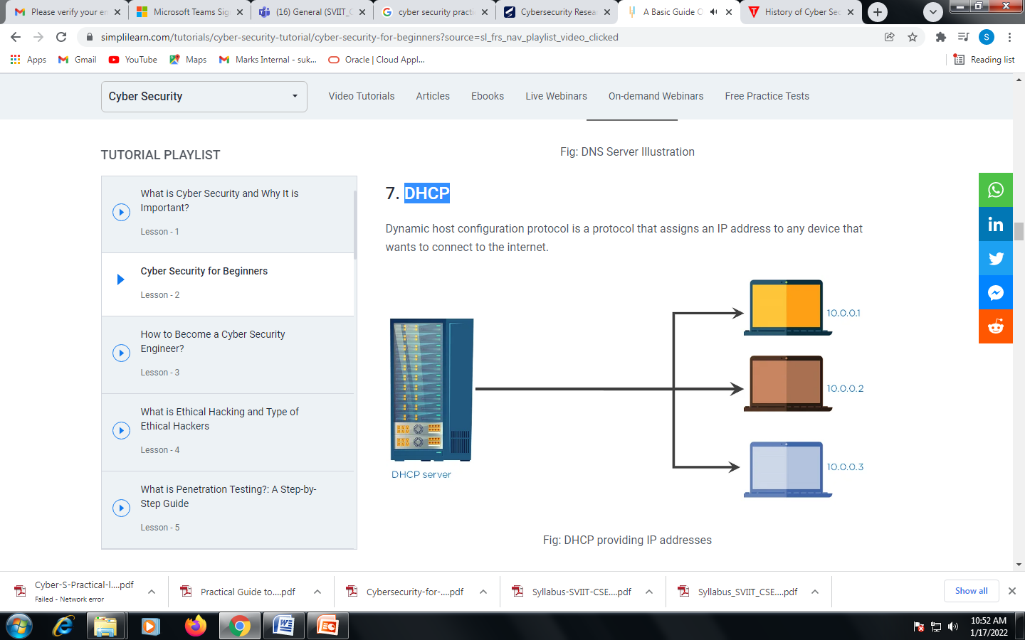
DHCP
Dynamic host configuration protocol is a protocol that assigns an IP address to any device that wants to connect to the internet.

Slide 11
Basic Terminologies
Router: This is a device that routes the data that comes to it and then sends that data to the destination to ensure that it is on the appropriate path.
Bots : Bots are computer programs that control your computer without your knowledge. They automatically send emails, retrieve web pages, and change computer settings.

Slide 12
Common Types of Attacks
There is always a motive behind every attack; the main reason for attacks is money. Hackers penetrate the system and then demand ransom from the victims. There are other reasons like a financial loss to the target, achieving a state’s military objective, damaging the reputation of the target, or political maneuvering.
There are mainly five types of attacks:
Distributed denial of service(DDoS)
Man in the middle
Email attacks
Password attacks
Malware attack

Slide 13
OSI Security Architecture
The OSI security architecture helps the managers responsible for the security of an organization in defining the requirements for security. The OSI security architecture was introduced as an ‘international standard’ which let the computer and communication vendor develop the products that have security features based on this architecture.

Slide 14
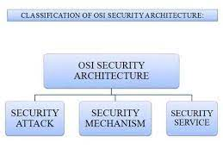
OSI Security Architecture

Slide 15
OSI Security Architecture Defines:
Security Attacks
Security Mechanism
Security Services

Slide 16
Security Attacks
Security attacks can be defined as an action that risks the security of information owned by the company. X.800 and RFC 4949 classifies the security attack into two types as discussed below:
Passive Attack
Active Attack

Slide 17
Passive Attack
Release of message content
Traffic analysis

Slide 18
Active Attack
Masquerade
Replay
Modification of message
Denial of services
Notes:
Masquerade
In masquerade active attack, the attacker pretends to be the sender. To understand it better consider that in the above figure 2 only path 2 is active in masquerade attack.
Replay
In the replay, the message is captured in a passive way and is retransmitted to produce an unauthorized effect. To understand replay, consider that in figure 2 path 1, 2 and 3 are active.
Modification of message
Modification of message means some data stream of the message is altered or modified to create an unauthorized effect. Path 1 and 2 are active in this kind of attack.
Denial of services
The attacker suppresses all the messages directed to a particular receiver by overloading the network to degrade the network performance

Slide 19
Security Mechanism
The security mechanism is an entire process that is specifically designed to identify the attack and develops a strategy to recover or prevent the attack.

Slide 20
Security Services
Security Services: Considering X.800’s security services the services can be classified into five categories as discussed below.
Authentication
Access Control
Data Confidentiality
Data Integrity
Nonrepudiation
Notes:
Authentication: It assures that the entity involves in the communication is the one it is claiming for.
Access Control: This service assures that only the authorized entities are accessing the resources and prevents unauthorized access.
Data Confidentiality: This service manages to maintain the confidentiality of data by preventing the exposure of the message content to the attacker.
Data Integrity: This service makes it sure that the data received at the receiver end is from an authorized entity.
Nonrepudiation: This service restricts the sending and receiving entity from denying the transmitted message.

Slide 21
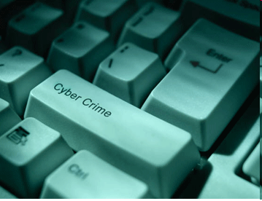
Introduction to Cyber Crime
Computer Crime, E-Crime, Hi-Tech Crime or Electronic Crime is where a computer is the target of a crime or is the means adopted to commit a crime.
Most of these crimes are not new. Criminals simply devise different ways to undertake standard criminal activities such as fraud, theft, blackmail, forgery, and embezzlement using the new medium, often involving the Internet

Slide 22

Computer vulnerability
Computers store huge amounts of data in small spaces
Ease of access
Complexity of technology
Human error
One of the key elements that keeps most members of any society honest is fear of being caught — the deterrence factor. Cyberspace changes two of those rules. First, it offers the criminal an opportunity of attacking his victims from the remoteness of a different continent and secondly, the results of the crime are not immediately apparent.
Need new laws and upgraded technology to combat cyber crimes

Slide 23
Different Types of Cybercrimes
Cyber crimes
Web jacking
Trojan
attacks
Hacking
Information
Theft
E-mail
bombing
Salami
attacks
Denial of
Service
attacks

Slide 24
Types of Cyber crimes
Credit card frauds
Cyber pornography
Sale of illegal articles-narcotics, weapons, wildlife
Online gambling
Intellectual Property crimes- software piracy, copyright infringement, trademarks violations, theft of computer source code
Email spoofing
Forgery
Defamation
Cyber stalking (section 509 IPC)
Phishing
Cyber terrorism
Crime against Government
Crime against property
Crime against persons

Slide 25
TYPES OF CYBER CRIMES
E-Mail bombing: Email bombing refers to sending a large amount of e-mails to the victim resulting in interruption in the victims’ e-mail account or mail servers.
Data diddling: This kind of an attack involves altering the raw data just before it is processed by a computer and then changing it back after the processing is completed.
Salami attacks: These attacks are used for the commission of financial crimes. The key here is to make the alteration so insignificant that in a single case it would go completely unnoticed e.g. A bank employee inserts a program into bank’s servers, that deducts a small amount from the account of every customer
Denial of Service: This involves flooding computer resources with more requests than it can handle. This causes the resources to crash thereby denying authorized users the service offered by the resources.

Slide 26
Some common cybercrimes…
Phishing, the mass distribution of “spoofed” e-mail messages,
which appear to come from banks, insurance agencies, retailers or credit card companies and are designed to fool recipients into divulging personal data such as account names, passwords, or credit card numbers.
“Carding,” which entails using stolen credentials (and can include package reshipping, money moving, and identity theft schemes)
Compromised servers or “bots,” which may be launching cyber attacks or sending Spam

Slide 27
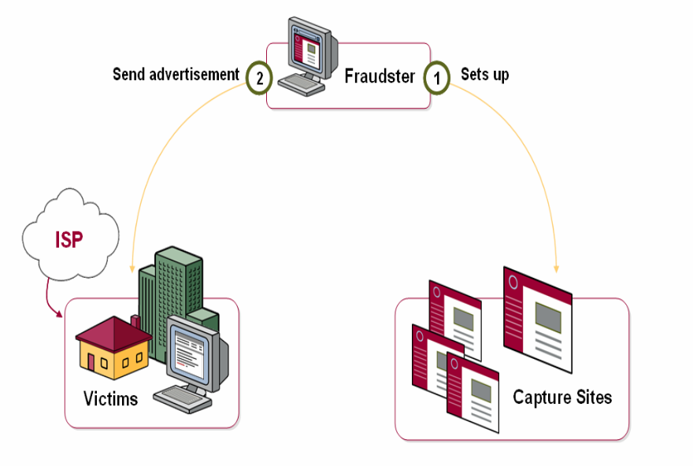
Cyber Crime Data In Regional Context
Carding:-
Carding is a serious threat to India, as it does not require a high degree of sophistication and is considered particularly pernicious by international financial institutions and e-commerce providers.
Bots:-
Bots, compromised servers that may be launching cyber attacks or sending Spam, were detected in the India IP space, including servers with the domain name.
Phishing:-
ISPs were able to point to a few examples of phishing capture sites being located on their servers, one targeting eBay (a frequent attack point for phishers).
Notes:
Carding (also known as credit card stuffing and card verification) is a web security threat in which attackers use multiple, parallel attempts to authorize stolen credit card credentials. Carding is performed by bots, software used to perform automated operations over the Internet. The objective of carding is to identify which card numbers or details can be used to perform purchases.
Besides the damage caused to card owners, a carding attack can negatively affect businesses whose websites are used to authorize stolen credit cards. Carding typically results in chargebacks – these are disputed transactions that result in a merchant reversing the transaction and refunding the purchaser’s money.
Chargebacks can happen for legitimate reasons (for example an erroneous purchase or a clerical error), but are very often the result of fraud techniques like carding. Every chargeback hurts a business’s reputation with credit card processors. Carding executed against a website can lead to poor merchant history and chargeback penalties.
Phishing is a type of social engineering attack that is employed by hackers or third-party unauthorized users to steal user data which mostly includes login credentials and credit card numbers or any other sensitive information.
Phishing tools are the majorly used in hacking for primarily three reasons:
1) Easy to use
2) You can get many Victims.
3) Anybody can use phishing without having prior knowledge of Programming or Scripts.

Slide 28
Computer Viruses
Viruses
A computer virus is a computer program that can infect other computer programs by modifying them in such a way as to include a (possibly evolved) copy of it. Note that a program does not have to perform outright damage (such as deleting or corrupting files) in order to be called a "virus".
A computer virus is a program that can copy itself and infect a computer without permission or knowledge of the user.

Slide 29
Why Do people Create These Viruses?
To distribute political message.
To attack the products of specific companies.
Some consider their creations to be works of art, and see as a creative hobby.
Financial gain from identity theft

Slide 30
Types of Viruses
Types of viruses
Armored virus
Companion virus
Polymorphic virus
Macro virus
Boot sector virus
Stealth virus
Logic bomb
Sparse infector
Network viruses

Slide 31
Cyber Threats
Cyber Threats
Cyber threats to a control system refer to persons who attempt unauthorised access to a control system device and network using a data communications pathway.
Main threats to cyber crime is Hacking.
Hacking involves gaining unauthorised access to a computer and altering the system in such a way as to permit continued access, along with changing the configuration, purpose, or operation of the target machine, all without the knowledge or approval of the systems owners.

Slide 32
New Internet Threats
All computers need internet security
Home users can lose valuable personal data with one click to the wrong website. Children trading games also exchange viruses unknowingly. You receive an email requesting an update to your payment details, and a hacker gains access to your bank account. A backdoor is installed on your machine, and your PC becomes a zombie, spewing out spam.
New technologies - new anti-malware solutions
As cyber threats have evolved, so has software to deflect such threats. Sophisticated antispyware and antivirus solutions capable of detecting the most complex new viruses are now available.

Slide 33
What Is Spam
Spam is the equivalent of physical junk mail and unsolicited telemarketing phone calls. It has become one of the largest nuisances to computer users for both home and business users.
There are two main types of spam, and they have different effects on Internet users.Cancellable Usenet spam is a single message sent to 20 or more Usenet newsgroups. (Through long experience, Usenet users have found that any message posted to so many newsgroups is often not relevant to most or all of them.) Usenet spam is aimed at "lurkers", people who read newsgroups but rarely or never post and give their address away. Usenet spam robs users of the utility of the newsgroups by overwhelming them with a barrage of advertising or other irrelevant posts. Furthermore, Usenet spam subverts the ability of system administrators and owners to manage the topics they accept on their systems.
Email spam targets individual users with direct mail messages. Email spam lists are often created by scanning Usenet postings, stealing Internet mailing lists, or searching the Web for addresses. Email spams typically cost users money out-of-pocket to receive. Many people - anyone with measured phone service - read or receive their mail while the meter is running, so to speak. Spam costs them additional money. On top of that, it costs money for ISPs and online services to transmit spam, and these costs are transmitted directly to subscribers.

Slide 34
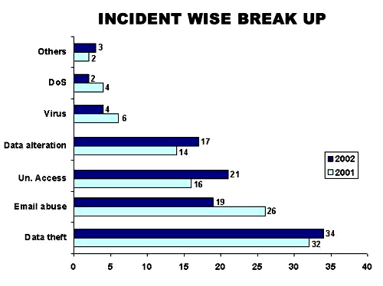
Frequency of incidents of Cyber crimes in India
Denial of Service:
Section 43
Virus: Section:
66, 43
Data Alteration:
Sec. 66
U/A Access
: Section 43
Email Abuse
: Sec. 67,
500, Other IPC Sections
Data Theft
: Sec 66, 65
Source: Survey conducted by ASCL

Slide 35
Frequency of reporting Cyber crimes in India
During the year 2005, 179 cases were registered under IT Act as compared to 68 cases during 2004 21.2% cases reported from Karnataka, followed by Maharashtra(26) , Tamil Nadu(22) and Chhattisgarh and Rajasthan (18 each) out of 179 cases, 50% were related to Section 67 IT Act.,125 persons were arrested. 74 cases of hacking were reported wherein 41 were arrested.

Slide 36
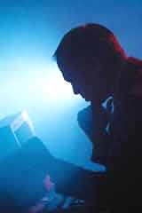
Combating cyber crimes
Technological measures- Public key cryptography, Digital signatures ,Firewalls, honey pots
Cyber investigation- Computer forensics is the process of identifying, preserving, analyzing and presenting digital evidence in a manner that is legally acceptable in courts of law.
These rules of evidence include admissibility (in courts), authenticity (relation to incident), completeness, reliability and believability.
Legal framework-laws & enforcement

Slide 37
Combating Cyber crime-Indian legal framework
Information Technology Act, 2000-came into force on 17 October 2000. Information technology Act 2000 consists of 94 sections segregated into 13 chapters. Four schedules form part of the Act.
Extends to whole of India and also applies to any offence or contravention there under committed outside India by any person {section 1 (2)} read with Section 75- Act applies to offence or contravention committed outside India by any person irrespective of his nationality, if such act involves a computer, computer system or network located in India
Section 2 (1) (a) –”Access” means gaining entry into ,instructing or communicating with the logical, arithmetic or memory function resources of a computer, computer resource or network
IT Act confers legal recognition to electronic records and digital signatures (section 4,5 of the IT Act,2000)

Slide 38
Civil Wrongs under IT Act
Chapter IX of IT Act, Section 43
Whoever without permission of owner of the computer
  Secures access (mere U/A access)
    Not necessarily through a network
  Downloads, copies, extracts any data
  Introduces or causes to be introduced any viruses or contaminant
  Damages or causes to be damaged any computer resource
    Destroy, alter, delete, add, modify or rearrange
    Change the format of a file
  Disrupts or causes disruption of any computer resource
    Preventing normal continuance of computer

Slide 39
Civil Wrongs under IT Act (Contd.)
  Denies or causes denial of access by any means
    Denial of service attacks
  Assists any person to do any thing above
    Rogue Websites, Search Engines, Insiders providing vulnerabilities
  Charges the services availed by a person to the account of another person by tampering or manipulating any computer resource
    Credit card frauds, Internet time thefts
  Liable to pay damages not exceeding Rs. One crore to the affected party
  Investigation by
  ADJUDICATING OFFICER
  Powers of a civil court

Slide 40
Data diddling: changing data prior or during input into a computer
Section 66 and 43(d) of the I.T. Act covers the offence of data diddling
Penalty: Not exceeding Rs. 1 crore
Case in point :
NDMC Electricity Billing Fraud Case: A private contractor who was to deal with receipt and accounting of electricity bills by the NDMC, Delhi. Collection of money, computerized accounting, record maintenance and remittance in his bank who misappropriated huge amount of funds by manipulating data files to show less receipt and bank remittance.

Slide 41
Section 46 IT Act
Section 46 of the IT Act states that an adjudicating officer shall be adjudging whether a person has committed a contravention of any of the provisions of the said Act, by holding an inquiry. Principles of Audi alterum partum and natural justice are enshrined in the said section which stipulates that a reasonable opportunity of making a representation shall be granted to the concerned person who is alleged to have violated the provisions of the IT Act. The said Act stipulates that the inquiry will be carried out in the manner as prescribed by the Central Government
All proceedings before him are deemed to be judicial proceedings, every Adjudicating Officer has all powers conferred on civil courts
Appeal to cyber Appellate Tribunal- from decision of Controller, Adjudicating Officer {section 57 IT act}

Slide 42
Section 47, IT Act
Section 47 of the Act lays down that while adjudging the quantum of compensation under this Act, the adjudicating officer shall have due regard to the following factors, namely-
(a) the amount of gain of unfair advantage, wherever quantifiable, made as a result of the default;
(b) the amount of loss caused to any person as a result of the default;
(c) the repetitive nature of the default

Slide 43
Cybercrime provisions under IT Act,2000
Offence Relevant Section
under IT Act
Tampering with Computer source documents Sec.65
Hacking with Computer systems, Data alteration Sec.66
Publishing obscene information Sec.67
Un-authorized access to protected system Sec.70
Breach of Confidentiality and Privacy Sec.72
Publishing false digital signature certificates Sec.73

Slide 44
Section 65: Source Code
Most important asset of software companies
“Computer Source Code" means the listing of programmes, computer commands, design and layout
Ingredients
  Knowledge or intention
  Concealment, destruction, alteration
  computer source code required to be kept or maintained by law
Punishment
  imprisonment up to three years and / or
  fine up to Rs. 2 lakh

